Slide 1
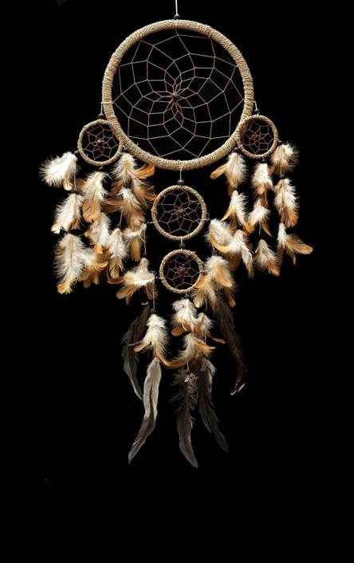
DREAM CATCHERS
"Don’t let someone else catch your dreams. You be the dream catcher."

Slide 2
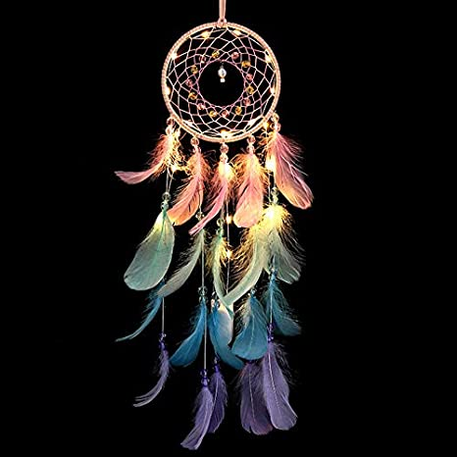
DREAM CATCHERS
A small hoop containing a horsehair mesh, or a similar construction of string or yarn, decorated with feathers and beads, believed to give its owner good dreams. Dream catchers were originally made by North American Indians.
It's commonly believed that the iconic hoop-and-web form is meant to protect sleepers from bad dreams by “catching” them, while letting good dreams pass through, hence the name.

Slide 3
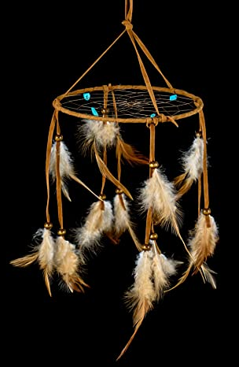
HISTORY
Dream catchers originated with the Ojibwe (or Chippewa) tribe.
They are considered filters for dreams. They block out the bad dreams and allow the good dreams to go on.
Historically feathers are placed in the dream catchers : Owl (WISDOM) feathers for girls. Eagle (courage) feathers for girls.

Slide 4
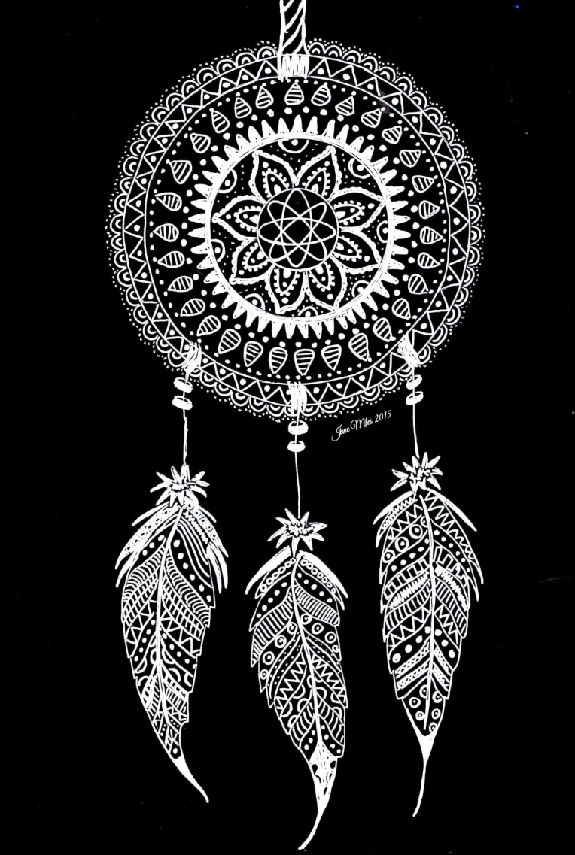
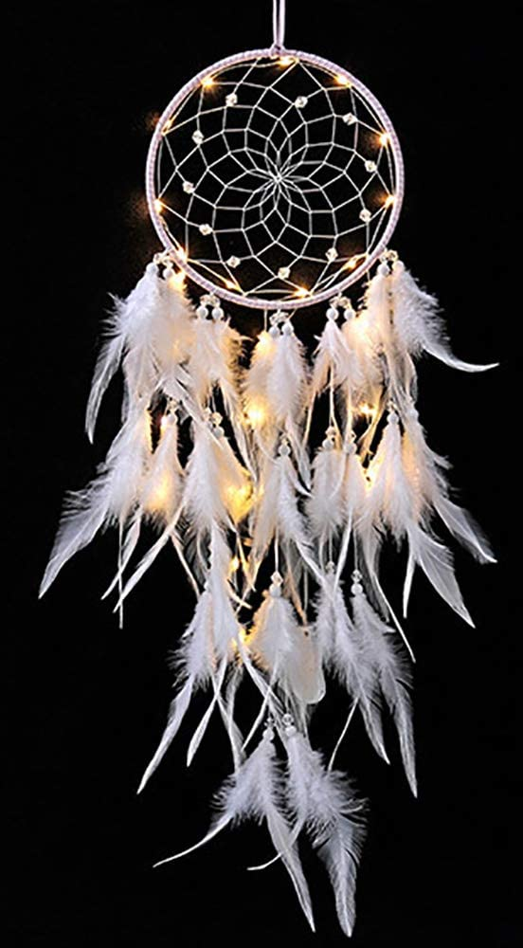
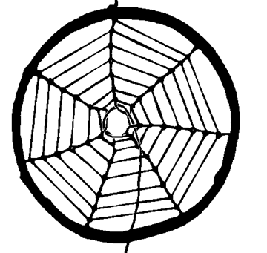
CONSTRUCTION HISTORY
Asibikaashi (spider woman) helps brings qiizis (sun) back to the people. She builds her lodge (web) before dawn to catch the light .
The bad dreams are destroyed by with the first light as the dew evaporates.
The small whole in the center allows the good dreams to come through.

Slide 5
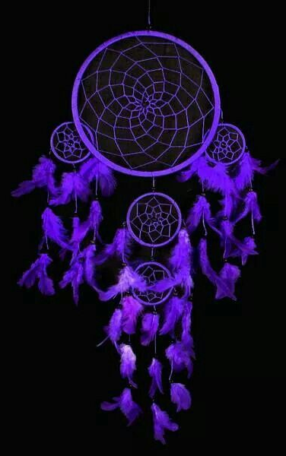
The circle shape of the hoop represents how giizis travels across the sky each day.
In the honor of Asibikaashi the web has 8 points for spider woman’s 8 legs.
The feather represents breath or air that is essential for life .

Slide 6
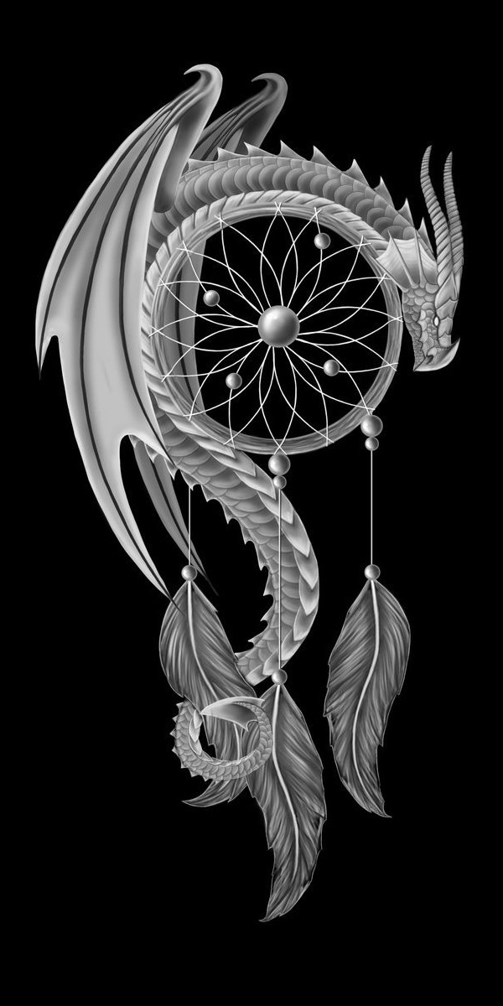
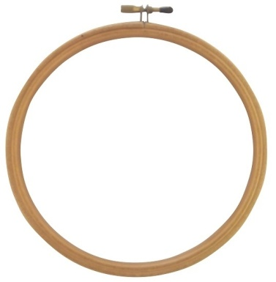
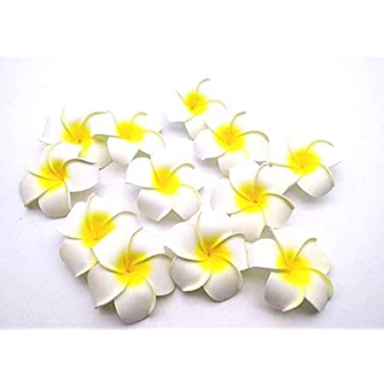
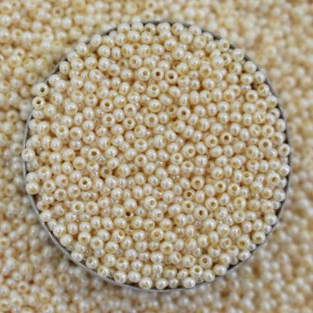
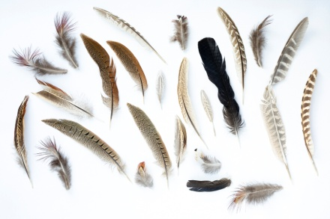
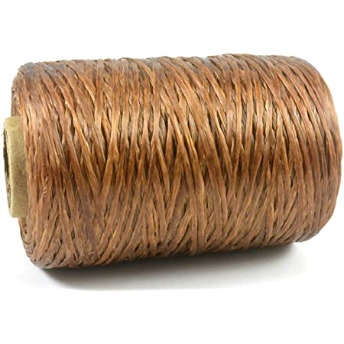
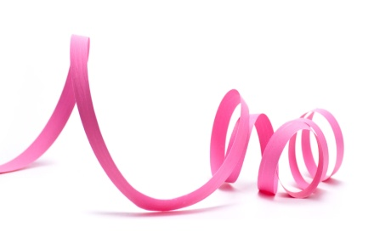
Materials
Embroidery Hoop
Flowers
Beads
Feathers
Vegan Sinew
Ribbon

Slide 7
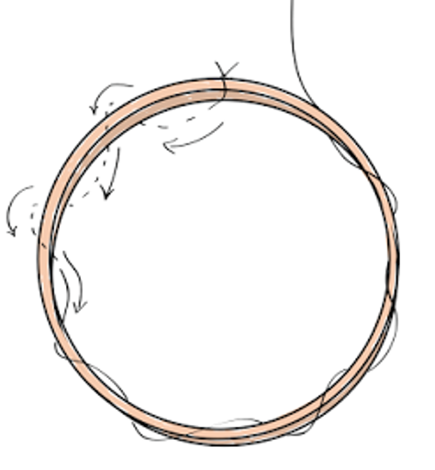
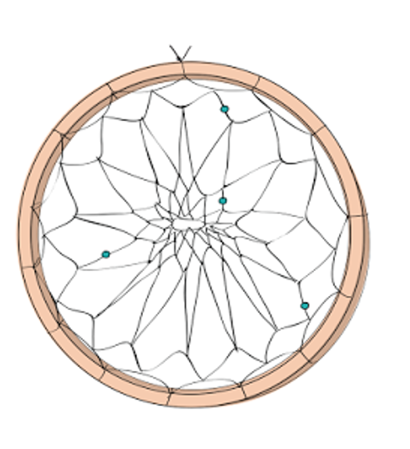
HOW TO MAKE A DREAMCATCHER?
1. Depending on the size of your hoop, cut one to two arm lengths of sinew. Tie the sinew at the top of the hoop, and wrap the sinew around the hoop so that it’s easily spaced.
2. Continue the pattern by threading the sinew through each loop that is made. Repeat the pattern until you reach the center and tie off. (you can also string beads on the sinew at random points for decoration).

Slide 8
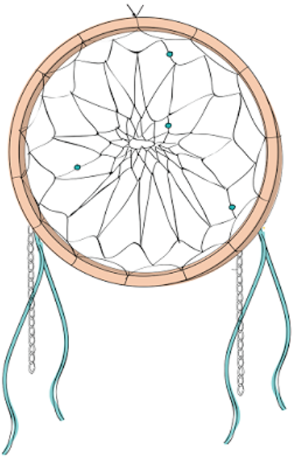
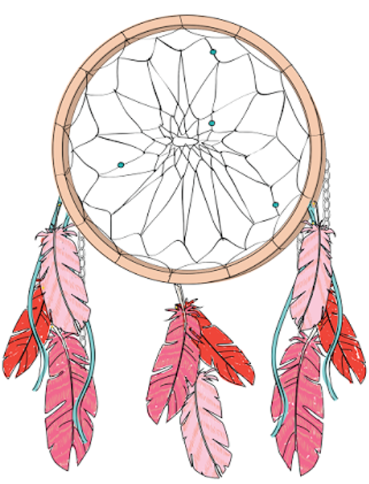
3. Cut varying lengths of yarn, chain, ribbon or anything else and tie them to the bottom of the dream catcher for fringe.
4. String beads on fringe and attach feathers with glue or by trying them on.

Slide 9
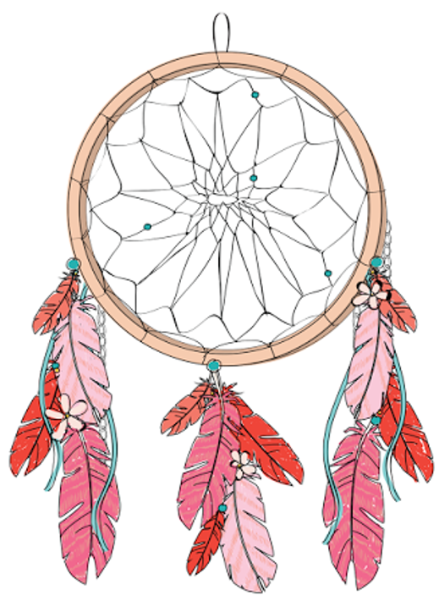
5. Tie a yarn loop at the top of the dream catcher, and hang over your bed, on the wall, or anywhere you like.

Slide 10
THANK YOU
Name – Alisha Hussain SAP ID - 1000016298

